Slide 1



Artificial Update of One-Day GIM-TEC Predictions Using the W-Index Map from the Preceding Hour
Tamara Gulyaeva¹ and Feza Arikan²
¹IZMIRAN, Moscow, Russia tam.gulyaeva@gmail.com
²Department EEE, Hacettepe University, Türkiye arikan@hacettepe.edu.tr
IRI Workshop, 6-10 October 2025, ICTP, Trieste, Italy

Slide 2
Introduction
Global Ionospheric Maps (GIM-TEC) are provided by various Data Analysis Centers with a one- to two-day delay including JPL 1h maps (jplr) with 1-day delay, rapid UPC-IonSAT maps (uqrg) with a 15-minute cadence with a 2-day delay, etc.
The only exceptions are the UPC-IonSAT products (uadg) which are provided by Universitat Politècnica de Catalunya in quasi- real time with a 15-minute cadence and a 2-hour UT delay.
Consequently, the real-time services provide forecasts of GIM-TEC for the current and subsequent days but the significant errors are still occur in those GIM-TEC forecasts.
Here we present a method for artificially updating Total Electron Content GIM-TEC maps hour by hour, based on the rotation of the W-index map from the preceding hour by 15 degrees westward called W-model.
The accuracy of TEC forecasting with W-model is compared with the correspondence between the different kinds of GIM-TEC, using UPC-IonSAT products uadg and uqrg, JPL products jplr, CODE 1-day forecast c1pg, and the relevant GIM-W index maps.
IRI Workshop, 6-10 October 2025, ICTP, Trieste, Italy

Slide 3


Data processing
W-model is produced hour by hour by the rotation of the W-index map from the preceding hour UT by 15 degrees westward.
So obtained GIM-W model is applied to -15 day running median GIM-MTEC produced for UT = 0, 1,…, 23 hrs from GIMs observed at 15 preceding days.
The model TEC at each cell is produced with Eqn.:
Coefficients are listed in the Table for the W-model values obtained above:
IRI Workshop, 6-10 October 2025, ICTP, Trieste, Italy

Slide 4
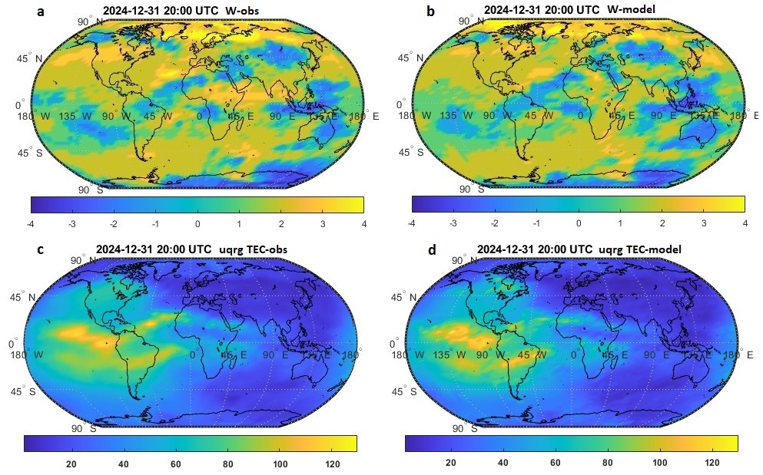
IRI Workshop, 6-10 October 2025, ICTP, Trieste, Italy
Results-1
Fig. 1 Model-data comparisons of global maps of W-index (top panel) and GIM-TEC (bottom) for quiet day (24 Dec 2024, 20:00 UT, Kp = 1.7):
(a) W-obs; (b) W-model; (c) uqrg TEC-obs; (d) TEC-model.
W-model (b) is obtained by rotation W-obs at 19:00 UT. TEC-model (d) is obtained from -15d TEC-median at 20:00 UT and W-model (b).

Slide 5
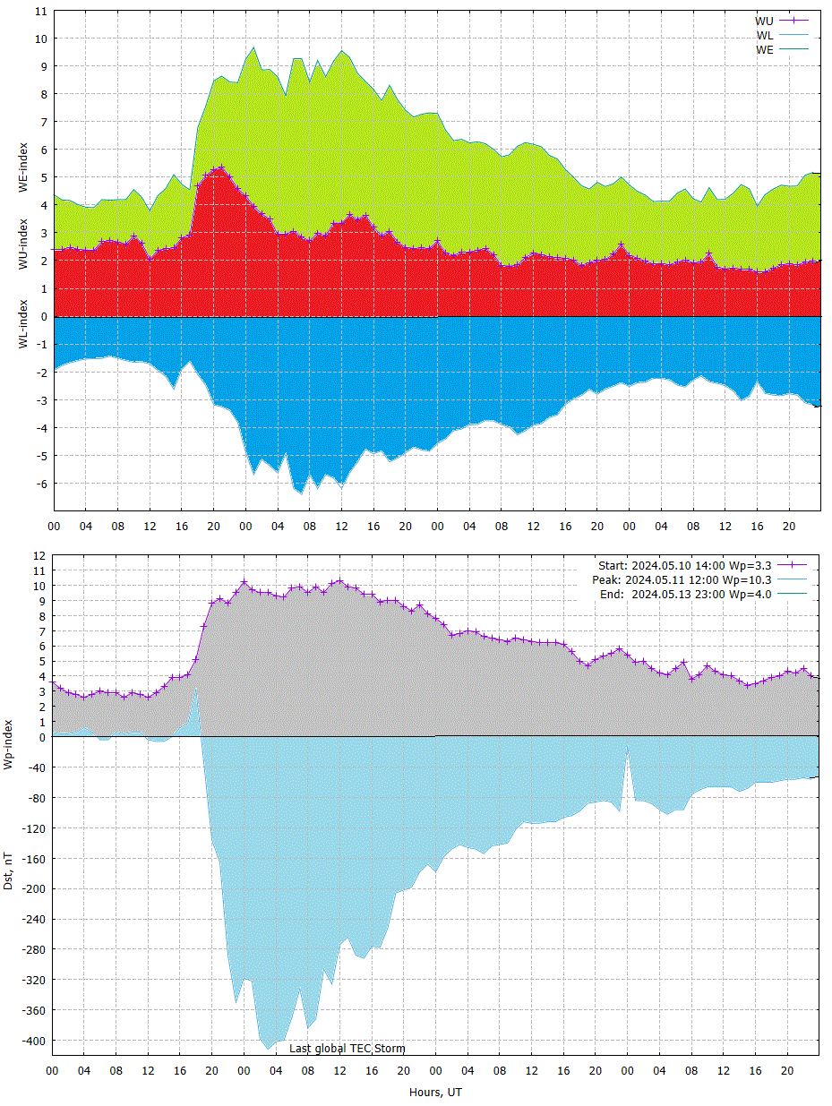
Results-2
Fig. 2 Global Electron Content GEC produced from global maps (left panel) and temporal variation of ionospheric WU, WL, WE and Wp indices and Dst plot (right panel) during the Monther’s Day superstorm on 10-13 May 2024 (Dst = -412 nT, Hpo = 10.7).
IRI Workshop, 6-10 October 2025, ICTP, Trieste, Italy

Slide 6
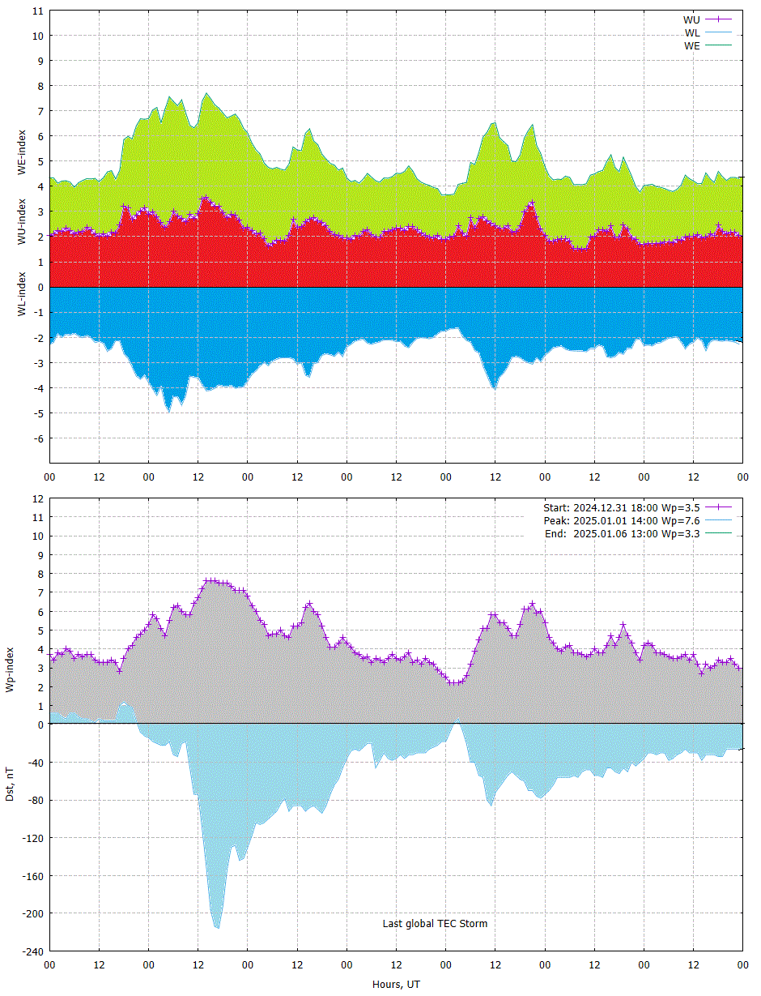
Results-3
Fig. 2 Global Electron Content GEC produced from global maps (left panel) and temporal variation of ionospheric WU, WL, WE and Wp indices and Dst plot (right panel) during the intense storm on 2024.12.31-2025.01.06 (Dst = -221 nT, Hpo = 9.3).
IRI Workshop, 6-10 October 2025, ICTP, Trieste, Italy

Slide 7
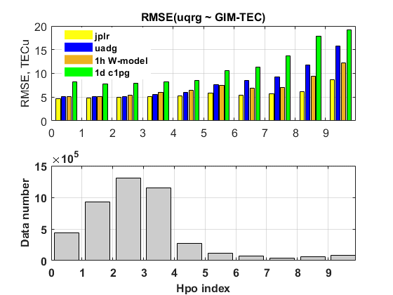
Results-3
Fig. 4 RMSE calculated between uqrg and 4 other GIM-TEC (jplr, uadg, 1h W-model and 1day c1pg forecast) during 36 quiet and strorm days: 10-13.05.2024, 31.12.2024, 1-31.01.2025 (upper panel).
Results are increased with growing geomagnetic Hpo index (1h equivalent to Kp). W-model results outperform uadg at high Hpo and c1pg in all cases.
Number of data points used for RMSE calculation (bottom panel).
IRI Workshop, 6-10 October 2025, ICTP, Trieste, Italy

Slide 8
Conclusions
For the first time a method is proposed for artificially updating Total Electron Content GIM-TEC maps hour by hour, based on the rotation of the W-index map from the preceding hour by 15 degrees westward (W-model).
The method is demonstrated by comparisons of Global Electron Content (GEC) from observed GIM-TEC with model results during super storm in May 2024 and intense storm in January 2025.
RMSE of GIM-TEC produced with W-model relative data uqrg outperform uadg at high geomagnetic activity and is less that c1pg results in all cases.
Proposed approach is best suitable to apply hour by hour with quasi- real time UPC-IonSAT products (uadg) which are provided by UPC with a 15-minute cadence and a 2-hour UT delay.
IRI Workshop, 6-10 October 2025, ICTP, Trieste, Italy

Slide 9
Acknowledgements
Jet Propulsion Laboratory (JPL) data base: https://sideshow.jpl.nasa.gov/pub/iono_daily/IONEX_rapid/
The Universitat Politècnica de Catalunya (UPC-ionSAT) GIMs: http://cabrera.upc.es/upc_ionex_GPSonly-RINEXv3/
The Earth Data NASA GIMs: https://cddis.nasa.gov/archive/gnss/products/ionex/
W-index maps are routinely produced from 1h JPL GIMs, jplr, and 15-min UPC maps uqrg and uadg GIM-TEC: https://www.izmiran.ru/ionosphere/weather/grif/Maps/.
W-index maps are provided online by IONOLAB : https://www.ionolab.org/index.php?page=index&language=en
IRI Workshop, 6-10 October 2025, ICTP, Trieste, Italy

Slide 10
Thank you!
IRI Workshop, 6-10 October 2025, ICTP, Trieste, Italy

